Slide 1
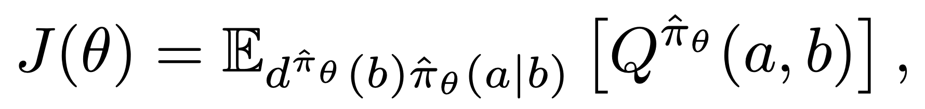
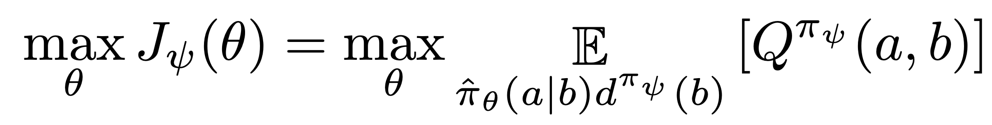
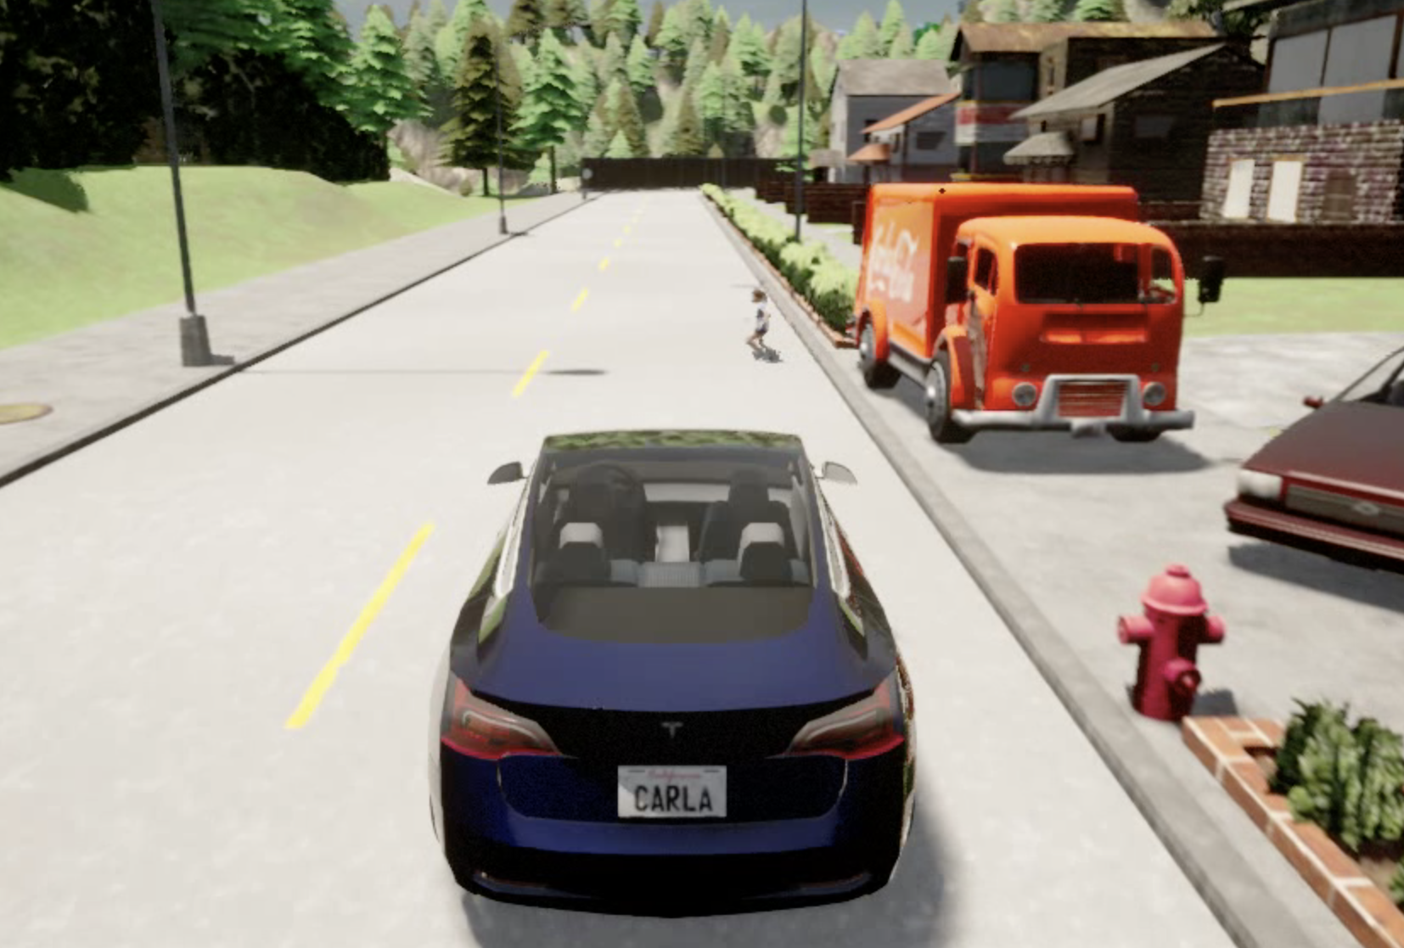
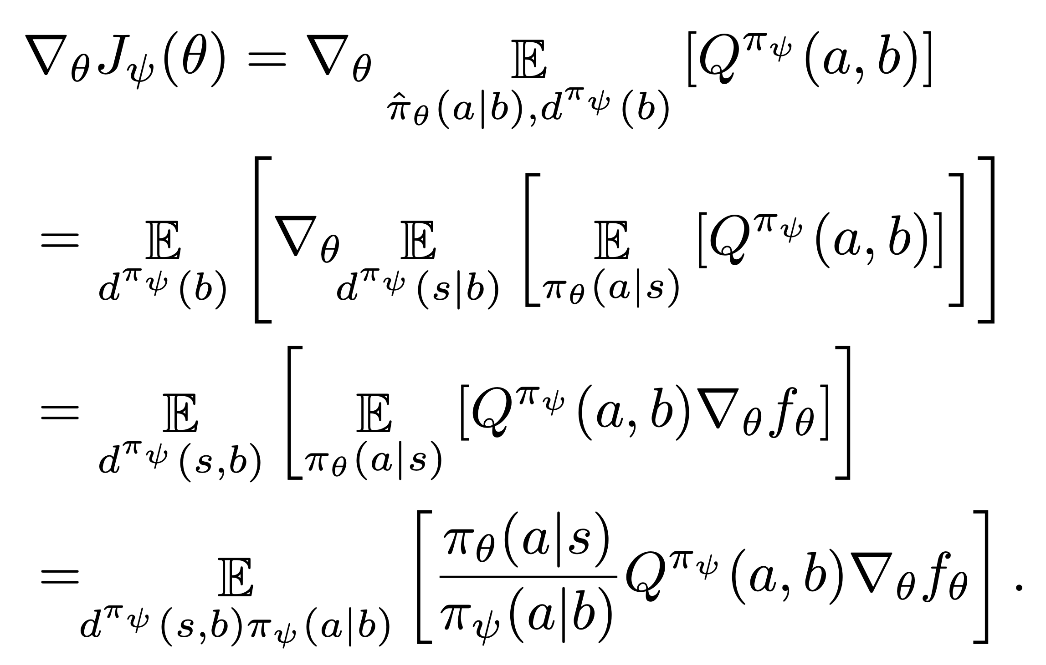
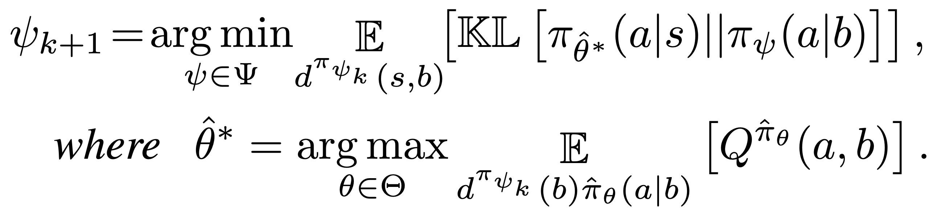
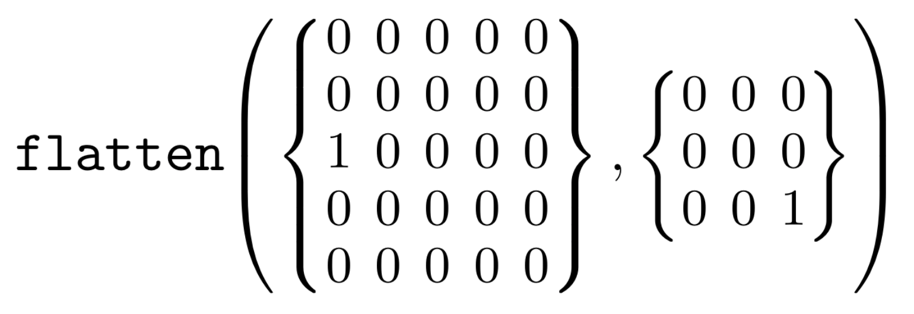
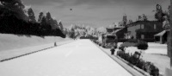
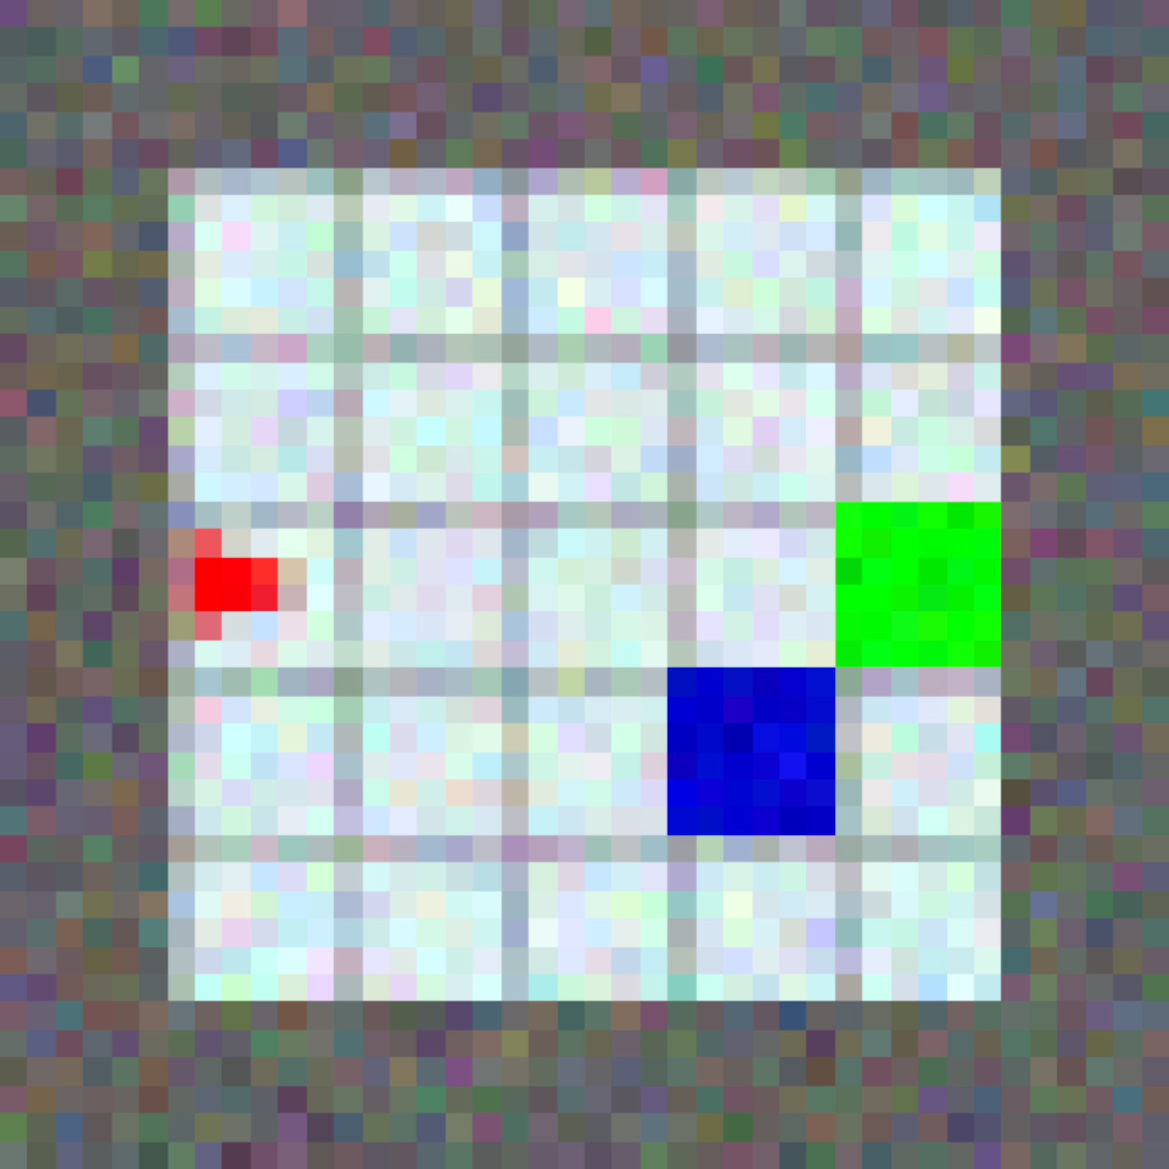
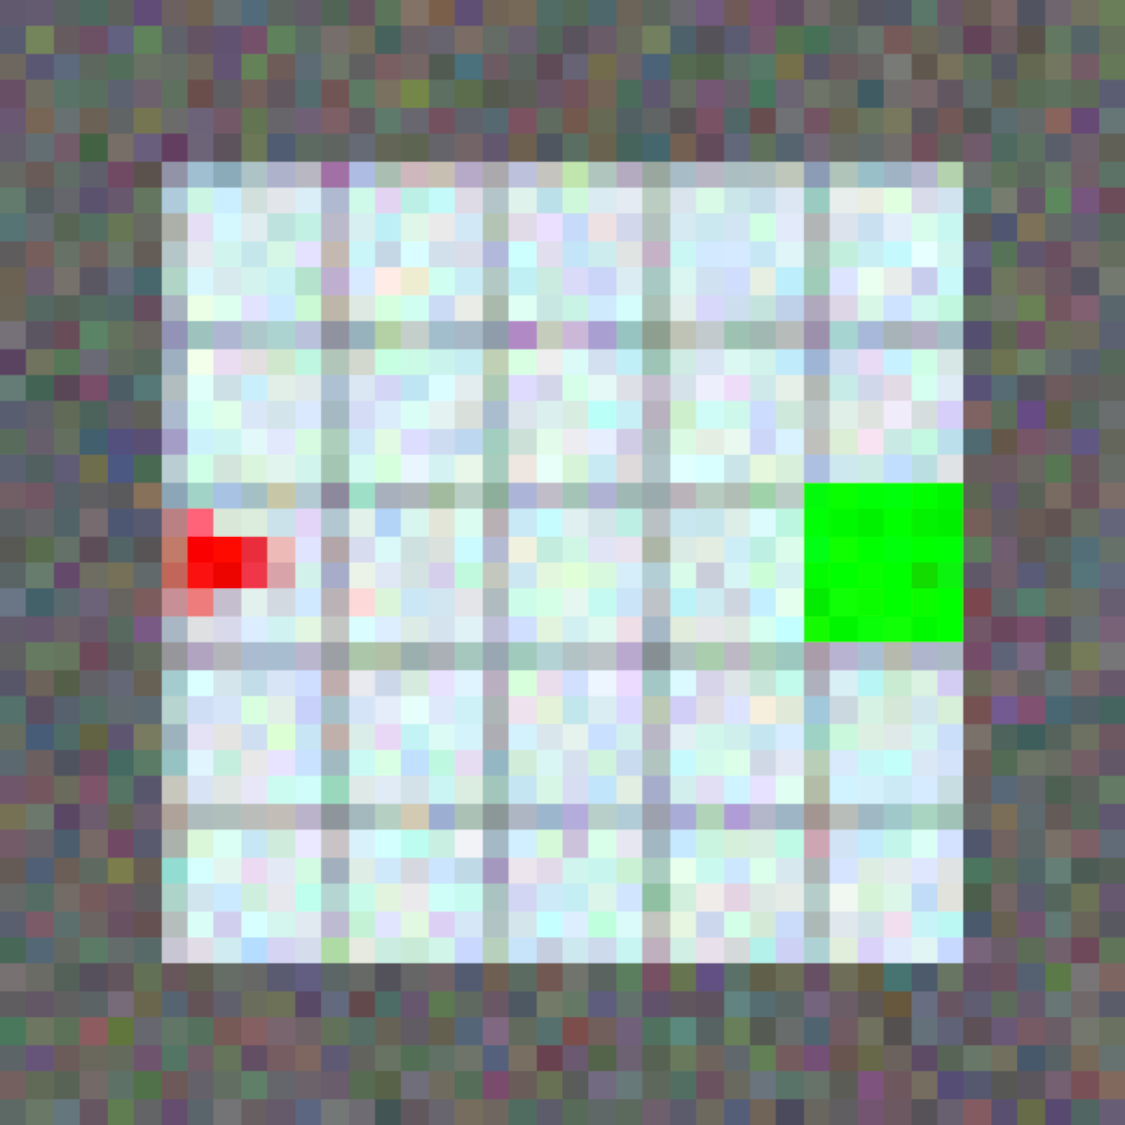
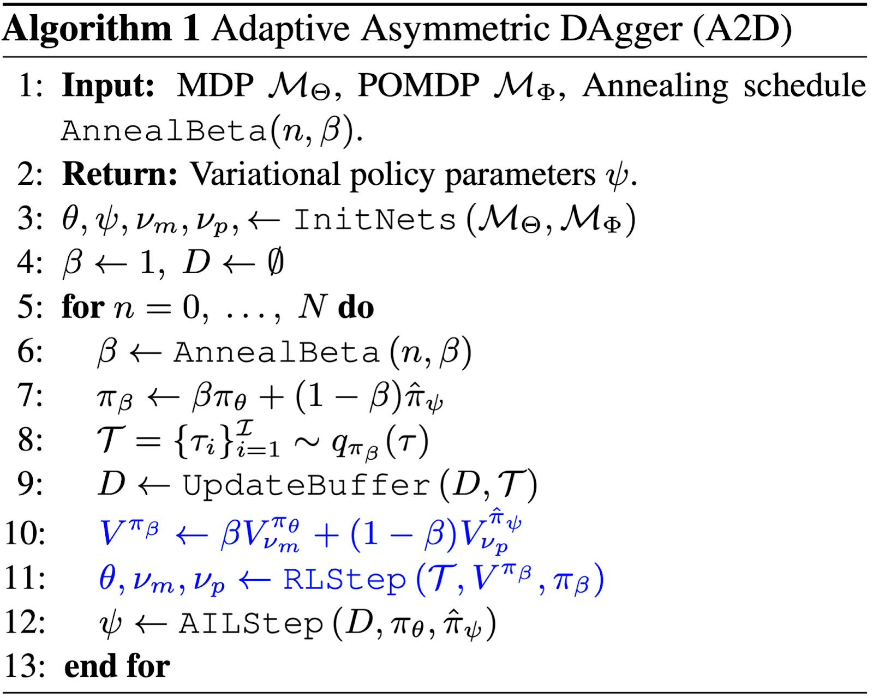
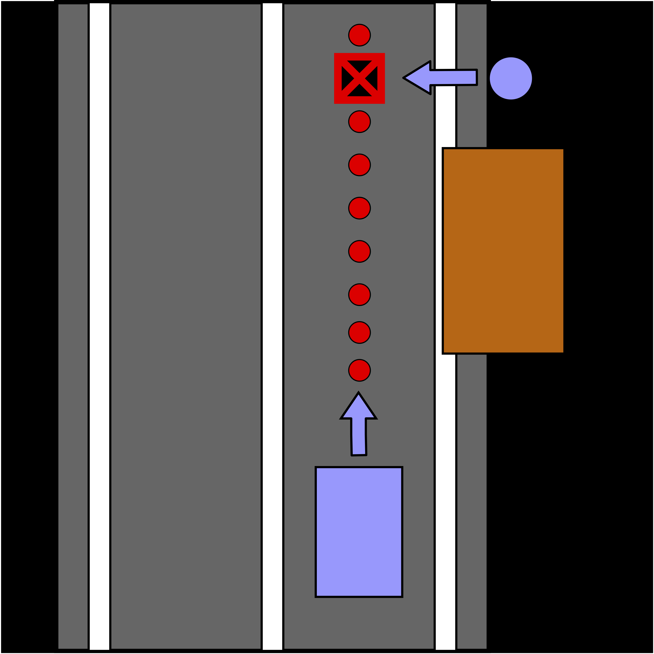
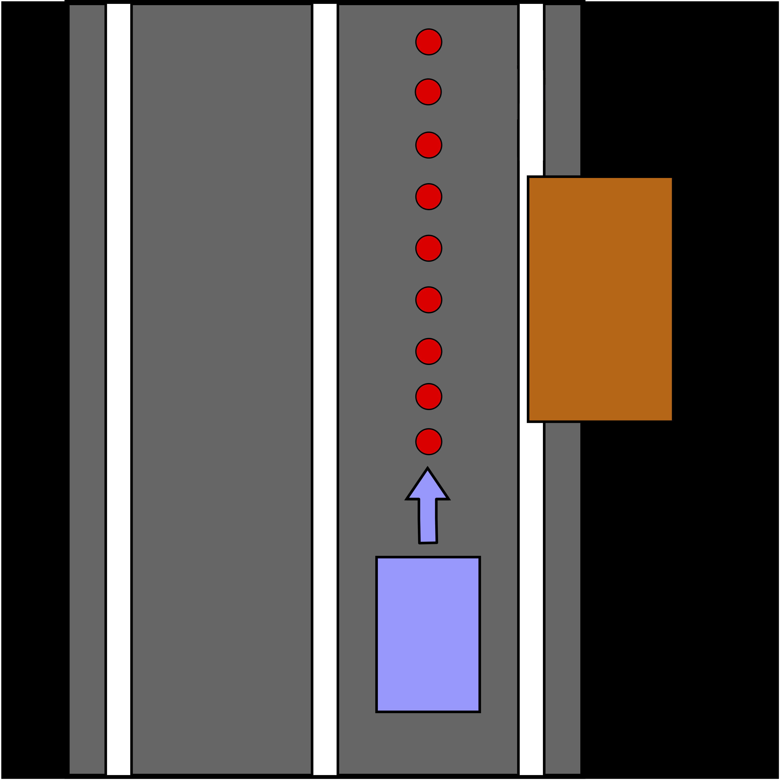
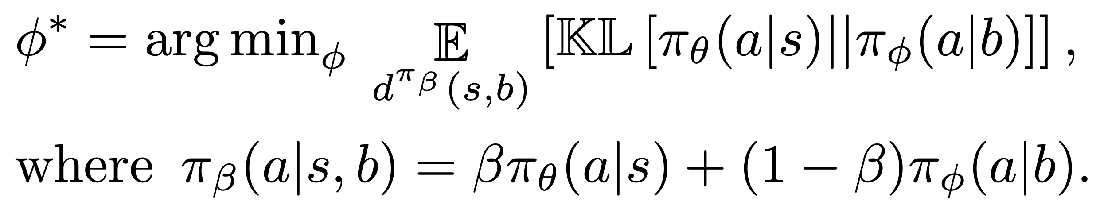
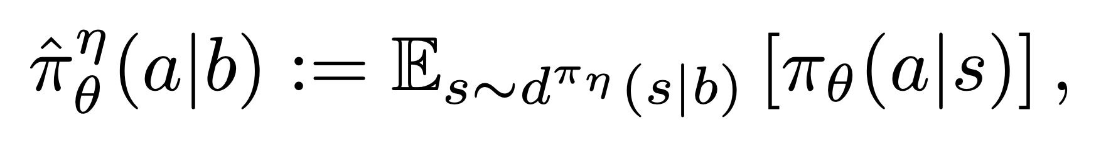
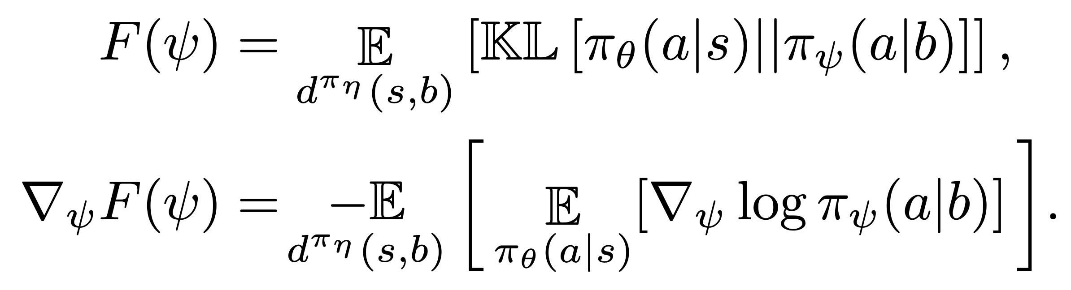
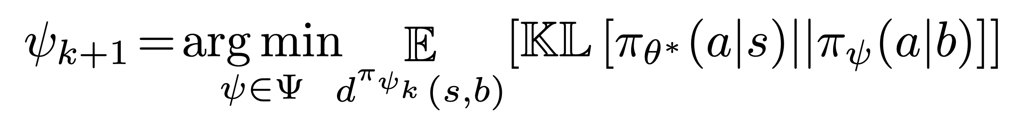

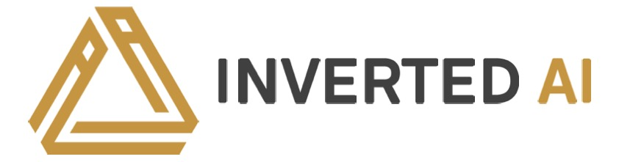
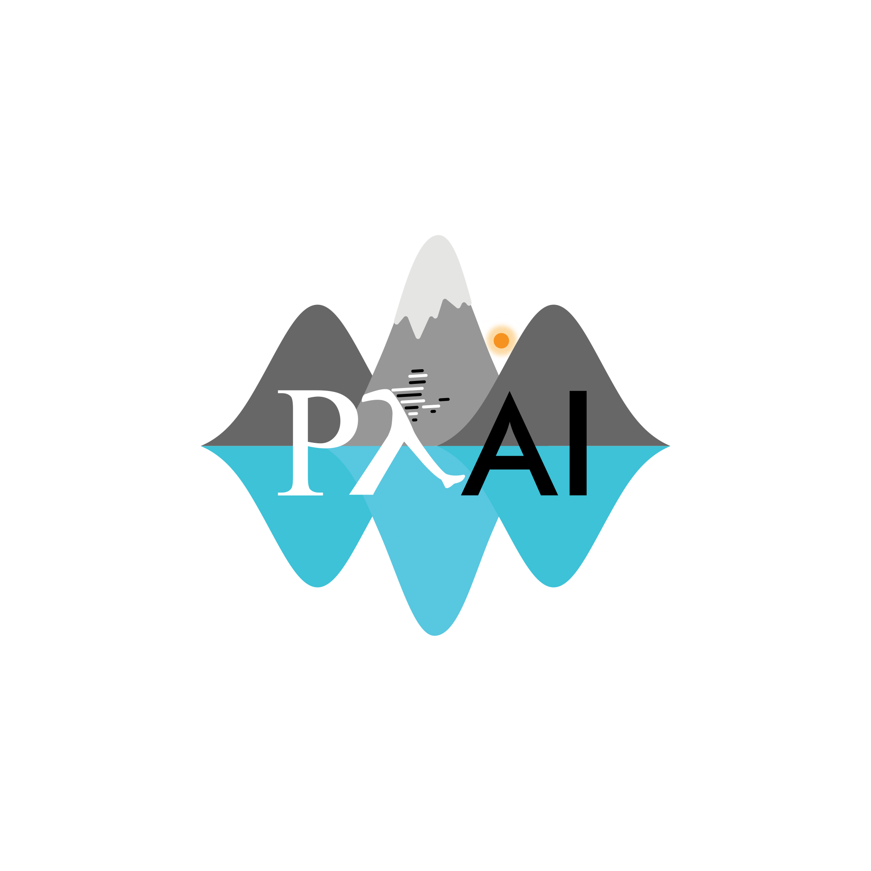
Robust Asymmetric Learning in POMDPs
Andrew Warrington*, J. Wilder Lavington*, Adam Ścibior, Mark Schmidt & Frank Wood
*Denotes Equal Contribution, Paper ID XXX, Poster Number XXX, email: XXX@XXX
TL;DR
Imitation learning and asymmetric information can expedite RL.
However, using both can lead to catastrophic policies.
We introduce Adaptive Asymmetric DAgger (A2D).
A2D updates the expert to maximize the reward of the trainee.
A2D Update
Define RL objective in terms of implicit policy:
Maximize over rollouts instead under current variational policy:
Theorem 3: Can define convergent iteration (under exact updates):
Autonomous Vehicles
Occluded hazard scenario, based on CARLA Challenge [cite].
-- A2d – MDP – RL etc
Asymmetric Environments
Can often extract extra information.
Referred to as asymmetric information.
May be complete state information.
May be more efficient representation.
A2D Algorithm
Builds directly on DAgger + RL.
Lines added to DAgger by A2D are shown in blue.
RLStep updates expert policy with IW gradient.
Value functions target value ahead independently.
AILStep is a DAgger step.
Asymmetric Imitation Learning
Learn agent (referred to as a trainee) by imitating expert.
Minimize KL-divergence between trainee and expert:
Definition 1 & Theorem 1: Solution to minimization is referred to as the implicit policy: (also discussed by Weihs et al. [2020])
Learn variational approximation:
Can define convergent iteration:
Definition 2 & Theorem 2: AIL is only guaranteed to recover the optimal trainee if the MDP and POMDP are identifiable:
Figure X.a: Top: Third-person view of the scenario. The car must drive to the end of the road to earn reward. A child runs out from behind the parked vehicle with fixed probability and must be avoided. Middle: Monocular camera view available to the agent/trainee. Bottom: Schematic of the scenario with and without the child, and the path of the vehicle.
Figure X.b: Top: A2D converges to a policy with a higher reward more quickly and reliably than direct RL. AIL converges almost immediately but to a bad policy. Bottom: A2D learns a policy that avoids the child with near certainty. Direct RL is unable to learn a policy that reliably avoids the child. AIL converges to a policy that impacts the child in a significant number of scenarios, as the reward penalty for this is not considered in AIL.
Gridworld
Help
Source Code & Additional Materials
Source code: www.github.com/plai-group/a2d
Also includes links and materials for talk, poster & paper.
Paper: www.arxiv.org/pdf/2012.15566.pdf
Key References
[pin2017a] Pinto, L., Andrychowicz, M., Welinder, P., Zaremba, W., & Abbeel, P. (2017). Asymmetric actor critic for image-based robot learning. Robotics: Science and Systems XIV.
[ros2011a] Ross, S., Gordon, G., & Bagnell, D. (2011). A reduction of imitation learning and structured prediction to no-regret online learning. Proceedings of the Fourteenth International Conference on Artificial Intelligence and Statistics (pp. 627-635). JMLR Workshop and Conference Proceedings.
[sch2015a] Schulman, J., Levine, S., Abbeel, P., Jordan, M., & Moritz, P. (2015). Trust region policy optimization. International conference on machine learning (pp. 1889-1897). PMLR.
[wei2020a] Weihs, L., Jain, U., Salvador, J., Lazebnik, S., Kembhavi, A., & Schwing, A. (2020). Bridging the imitation gap by adaptive insubordination. arXiv preprint arXiv:2007.12173.
Figure X.a: Top: Frozen Lake. Bottom: Tiger Door. Left: Reward plots for various approaches. We see that A2D converges to the optimal POMDP policy, in commensurate time for both representations. AIL converges quickly but to a to a bad policy. Direct RL converges slowly. Right: Divergence between expert and trainee policies during training. AIL is unable to reduce the divergence due to the inherent unidenfiability, whereas A2D converges to a low divergence.

